Slide 1

BUS7C3 International Organisational Branding
Lecture 3 – Models and Theoretical Concepts of International Organisational Employer Branding

Slide 2

Housekeeping
In the classroom we speak in English only!
Sit in your lecture groups.
All phones on silent.
Bring your student IDs – no ID no attendance.
Make sure you are here on time; late comers might not be allowed in, and your attendance will not be registered.
Make sure you attend your allocated lecture group, if you come to the wrong one, you will not get attendance.
When class starts, be quiet unless you are asking a question, or you are participating in a class activity – lecture time is not a time for you to chat with your friends.
No eating food in the theatre.
Make sure you clean up after yourselves – after the lecture, pick up any rubbish on the floor and put it in the bins provided.

Slide 3
Week 2 Recap
What are the key components of the employer brand?
What do we mean when we talk about target audience for employer branding?

Slide 4
This week’s learning outcomes
At the end of this session, you will be able to:
Conceptualise the role of branding from a theoretical perspective
Apply research and theory on the impact employer branding has within an international context
Present an abstract of your academic work and research to date in this subject area.

Slide 5
Models and Theoretical Frameworks
We are going to be analysing a few employer branding models, theoretical frameworks as well as discuss what the models mean to you.

Slide 6
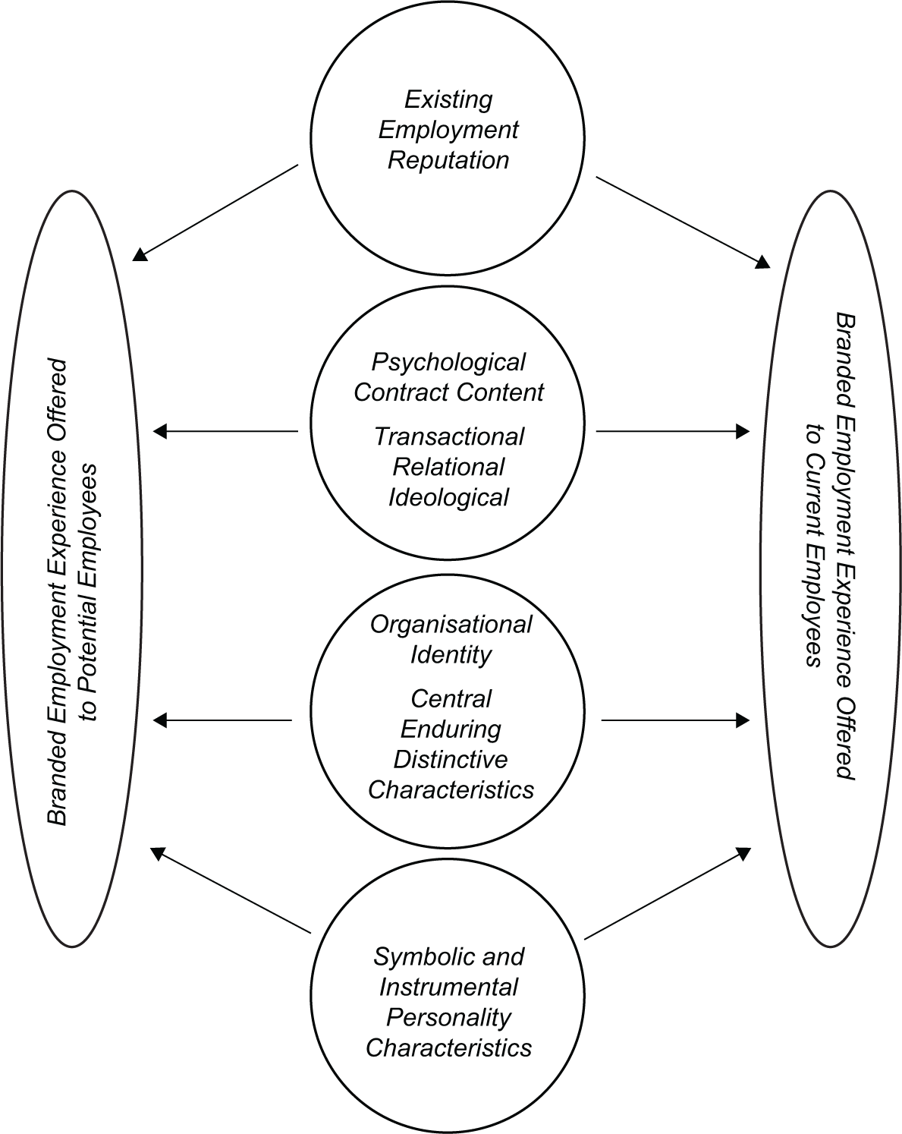
Employer branding
Figure 1: Employer
branding and
Organisational behaviour (OB) theory model

Slide 7
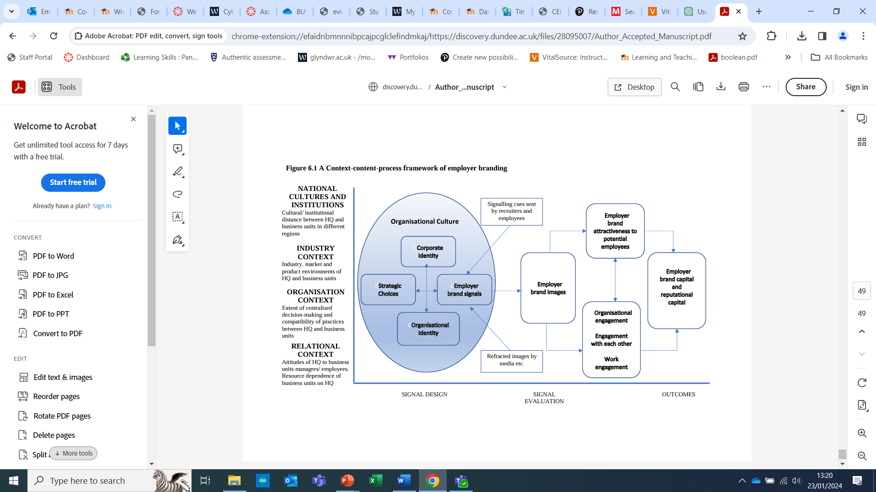
A Context-content-process framework of employer branding

Slide 8
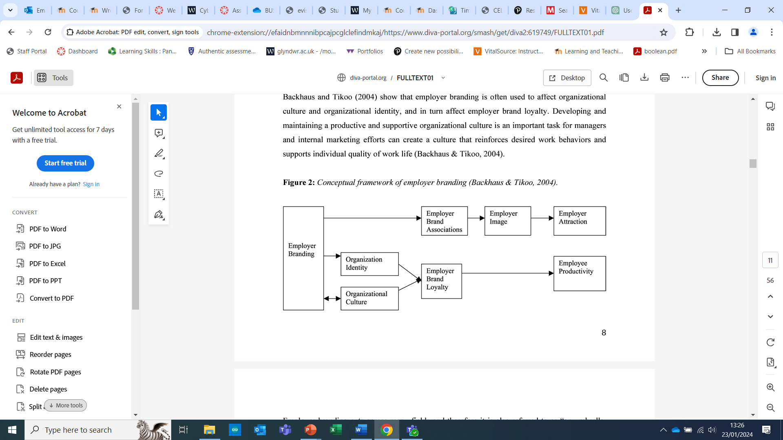
Employer branding framework
Figure 3: Employer branding as a three-stage procedure (Backhaus and Tikoo 2004)
Step 1: the comprehension of the organization, by understanding what the brand’s values and its main operational characteristics are;
Step 2: the creation of a “fascinating brand promise” for the employees;
Step 3: estimation of goals’ achievement, by developing internal indexes of effectiveness;
Step 4: the alignment of the methods applied to support branding; and
Step 5: the implementation of employers’ branding strategy in practice (Berthon et al. 2005).
Following these steps does not necessarily guarantee success in attracting the best employees when competition is high but can increase the possibility of maintaining high-skilled personnel already working in a brand and moreover can attract talents and senior level professionals.

Slide 9
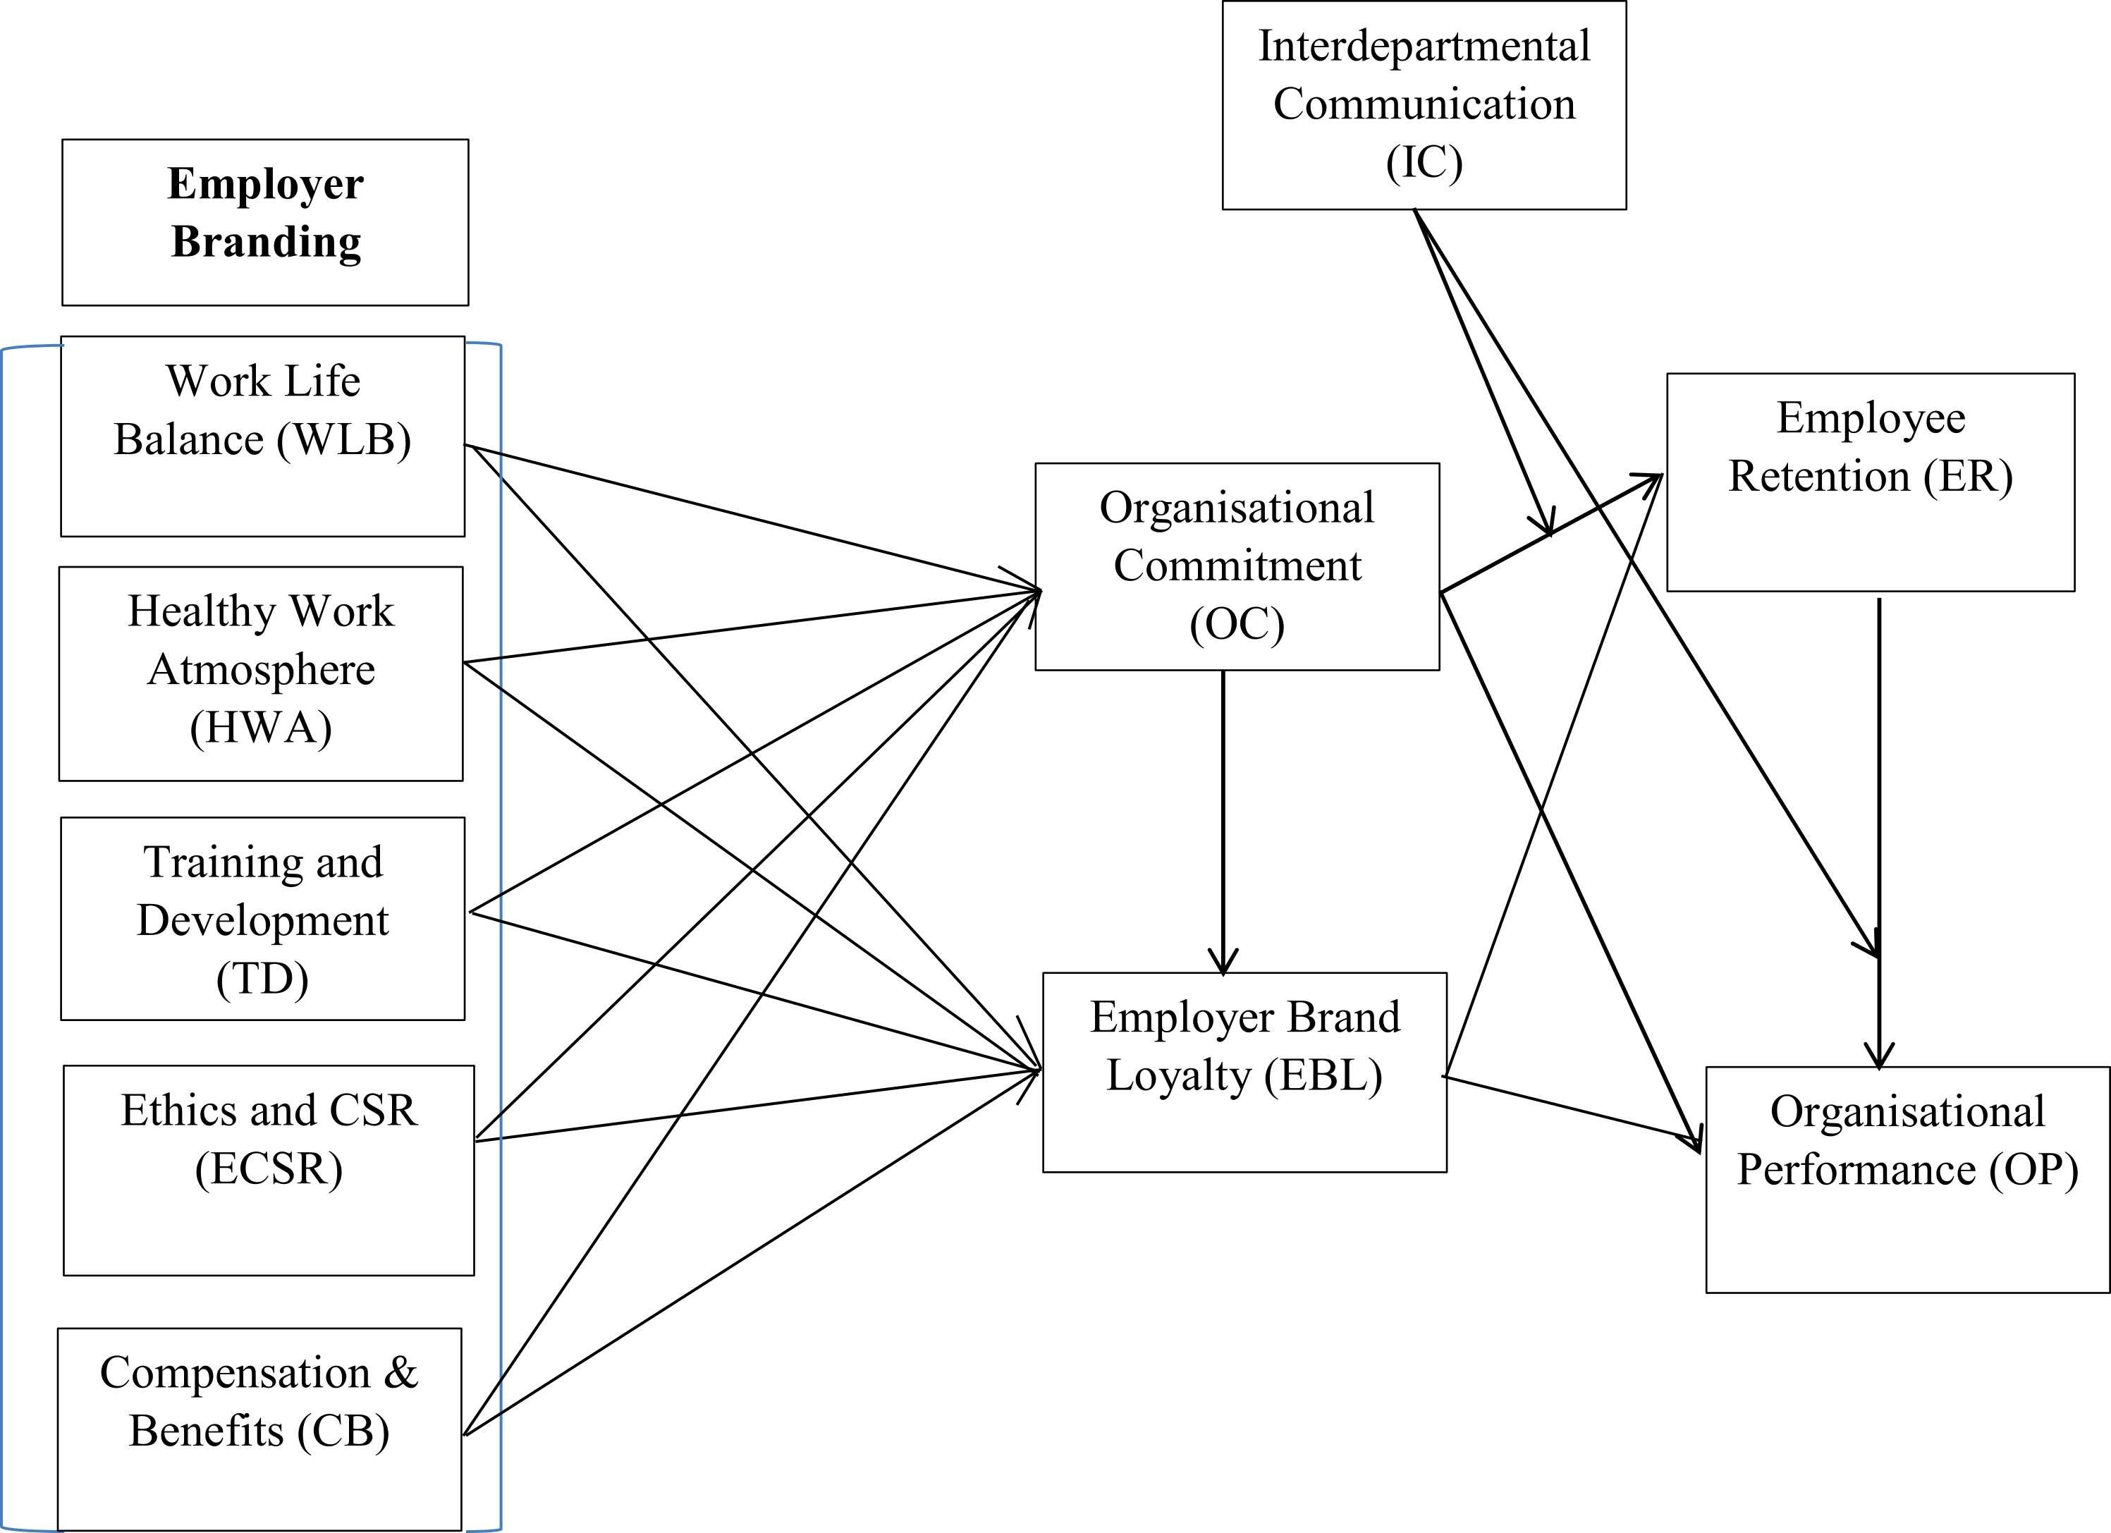
Employer Branding Wellbeing Model

Slide 10
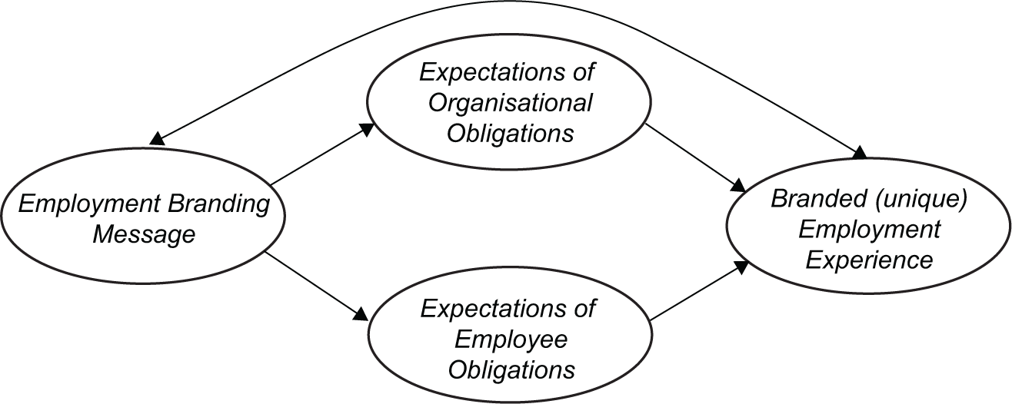
Psychological contract, employer brand and employment experience Model
Figure 5: The relationship between psychological contracts and employer branding.

Slide 11
Practical Session 1
VLOG day!
Today you are going to share the work and research you have conducted to date as you begin to develop your VLOG.
For this session you are going to decide on what information you are going to use, putting everything you have learned so far into practice.
You are also going to decide how you are going to display it – diagrams, graphics etc.
VLOGs require referencing to show evidence of your reading and research so you should always provide a reference list at the end.

Slide 12
Practical Session 1: Theme
Your VLOG theme is:
Develop a critical overview of how can employer branding advance an organisation’s competitive advantage?
Using the following academic source as the basis for your research:
Employer brand identifies an organisation in the marketplace and makes it unique (Giliver, 2009).
This activity will support learning outcomes 1 and 2.

Slide 13
Group Research Activity 1
In your groups you are required to complete the following:
The following are the companies you can choose from – your group has 5 minutes to decide on a company ……………

Slide 14


Slide 15
Group Research Activity 2
In your groups:
Conduct thorough research on your chosen company using in-class tools.
Pay particular attention to the points that pay particular attention to what attracts people and drives employer branding? Remember, employees and potential employees are our target audience.
Retention
Recruitment
Conduct
Reward
30 minutes

Slide 16
Group Research Activity 3
In your groups:
Undertake research on VLOGs and decide how you are going to design and structure your own VLOG. Use in-class resources such as google to conduct the search.
10 minutes

Slide 17
Class Re-group
By now you should have:
Chosen your company
Conducted in-depth research on that company
Researched academic posters
Decided up on a design and structure

Slide 18
Group Research Activity 4
Continuing in your groups:
Remember your VLOG theme/action: Develop a critical overview of how employer branding can advance an organisation’s competitive advantage?
Using the following academic source as the basis for your research: Employer brand identifies an organisation in the marketplace and makes it unique (Giliver, 2009).
30 minutes

Slide 19

Thank you!
Any questions?

